Slide 1
Inter-Government Ledger Overview Presentation. : Dec 2019
UN/CEFACT IGL Project Team

Slide 2
What problem are we solving?
Can a global “Inter Government Ledger” reduce the cost of cross-border trade by replacing paper based compliance processes with high integrity digitised ones?
UN/ESCAP – 44% of trade costs are related to border procedures
cost of trade is around 90% - which is too high.
Many FTAs are not claimed because the cost/complexity outweighs the saving.
WTO – 25% $80Tn global GDP is traded goods and average ad-valorem cost of trade is 90% for manufactured goods and 150% for agricultural produce. At least 5% is border admin (paper hassle) – so that’s $1Tn / yr globally of avoidable cost.

Slide 3
Certificates of Origin example
Despite our “digital world” there is still a mountain of physical paper documents in international trade processes that present non-tariff barriers to our exporters.
The Paper Process
Chamber
Exporting govt
Importing Govt
Paper Certificate
Exporter
Agent
Forwarder
Importer
HELP!
Certificates of Origin, for example, are
Issued by chamber to exporter
Provided to forwarder by exporter
Sent to importer via courier
Provided to customs agent by importer
Given to customs with clearance pack.
Goods may be held at port if the paper “doesn’t look right”

Slide 4
Better Certificates of Origin
Importing regulators have no way to trust authenticity of docs direct from parties in exporting country. But they will trust digital docs if they are sent via exporting regulator. The G2G channel solves the trust problem
The Digital Process
Chamber
Exporting Govt
Importing Govt
Digital Certificate
Exporter
Agent
Forwarder
Importer
Easy!
Back to certificates:
Digital data provided to Exporting Govt API by identified chamber (or exporter)
Forwarded securely to importing regulator and immediately validated.
All interested parties can verify the certificate is sent and valid.

Slide 5
It’s a cross-border problem
Paper Processes
Notice this hole
There’s nothing G2G
Digital Processes
Export
Ship
Import
Regulators
Regulators
Carriers
Seller
3PL
Agent
Buyer
Paper documents
Paper certificates
Most countries have very high digital uptake domestically – so the problem is not national
The paper problem is cross-border and it exists because there’s no cross border digital trust framework

Slide 6
G2G connections are the answer
Paper Processes
This bit of G2G magic has a huge impact
Digital Processes
Export
Ship
Import
National Single Window
G2G Pipelines
National Single Window
Inter-govt Ledger
API
API
API
API
Carriers
Seller
3PL
Agent
Buyer
National Identity Platform
Commercial Data Pipelines
National Identity Platform
e.g. GovPass
e.g. TradeLens
The Inter-Government Ledger is a trust bridge that connects together existing digitised national processes to provide a high integrity international framework – replacing paper documents with high integrity digital processes.

Slide 7
What is an Inter-Govt Ledger (IGL)?
A high integrity G2G channel that requires no centralised infrastructure, recognises the autonomy of each country, and supports any cross border process (initially origin data exchange).
This bit is the IGL
It is essentially a single window interoperability framework. Single windows reduce friction in domestic processes. The IGL connects single windows to reduce friction in cross-border processes.

Slide 8
Yes but will it really work?
Maybe – there are two big questions to answer.
The Australian Government has completed a proof of technology and published the implementation as open source at https://trustbridge.github.io . The PoT demonstrated an IGL that supported multiple countries, multiple processes (CoO and DoO) on multiple channels (Ethereum, hyperledger). So, yes, it’s feasible and affordable.
Is it technically feasible?
The IGL specification is being developed as an open project under UN governance. It’s got a lot of interest – around 10 countries on the team and WCO, WTO, WEF are also watching. Workshops completed in Singapore and London in 2019 and first draft specification is due end Dec 2019..
Will other countries play along?

Slide 9
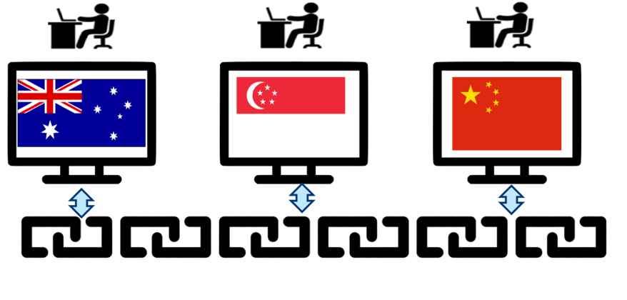
How it works – business overview
The demo scenario shows both fully digital and “digital linked paper”
Exporters can send digital CoO and get immediate acknowledgment.
The paper version can have a QR code to support easy validation.
Verify
Declaration
of Origin
Declaration
of Origin
Blockchain
digital pathway
Paper pathway

Slide 10
How it works – two countries
The importing regulator trusts the exporting regulator to identify the CoO issuer
Only two things to agree!
Transaction hash = “kfESTOv24o31skyXUrhGXTD+j1kZ6FAvLlqCOu1Yhh4=”
Exporting Jurisdiction = “AU”
Importing Jurisdiction = “CN”
On Chain Data
Repository API
GET repository.gov.au/digitalassets/kfESTOv24o31skyXUrhGXTD+j1kZ6FAvLlqCOu1Yhh4=
Importing regulator
Exporting Regulator
regulated community
GET CoO
regulated community
Governs
New Transaction
Governs
證書
CoO App
Uses
Uses
Inter-customs Blockchain Ledger
Repository
Repository
API
API
API

Slide 11
How it works – multiple countries
There will be many separate ledgers – perhaps one per FTA or per multilateral framework (eg ASEAN). But consistent standards will permit interoperability.
Key
exchange
China Government
NZ, UK, US, CA, TH, VN, RU, etc etc
Australian Government
Korean Government
證書
EU
Japanese Government
User I/F
CoO App
증명서
API
Repository
Certificat
証明書
API
API
API
Inter-customs Ledger
GET
API
API
New Transaction
hash = “kfESTOv2…”
Exporter = “AU”
Importer = “JP”
API
API
API
API

Slide 12
The layered data exchange model
Documents remain in-country, only minimal data is on-chain
Channel layer
A uniquely identified entity in accordance with the edi3 identity specification
eg : chamber.com.au:certificateOfOrigin:123456789
On Chain Message
All countries on the channel see the message, whether they are the recipient or not. However, multiple isolated channels are supported
Sender : Receiver
A multi-hash of the linked data payload that holds the detailed data
eg : EiCcvAfD+ZFyWDajqipYHKICkZiqQgudmbwOEx2fPiy+Rw==
Subject
Object
Predicate
On Chain
The event that triggered the message in edi3 dictionary JSON-LD lexicon
eg : dictionary.edi3.org/regulatory/certificateOfOrigin.status.acquitted
G2G Channel API
Linked-data layer
All data is JSON-LD in accordance with the dictionary.edi3.org lexicon. All links to objects are notarized with a multi-hash.
Maintained in send country repository and accessible only to the recipient country of the corresponding ICL message. If you got the ICL message you can get the linked data.
Linked Data Payload
Shipped
consignment:
99887766
abn: 1122334
Issued
coo:
123456789
certified
document
goods
jwt: ab445g24
Pdf:
887765
invoice:
887765
B2G Message API
Pegged side tree
Object layer
Maintained in any repository accessible to sending country and made available to recipient country only if there is a matching access policy. You can get the linked object if the policy says you can
Token
Subject
Claim
Authority
{“CoO”:{
“id”:”12345..9”,
“issuer”:”ACCI”,
“consignee”:”..”,
“consignor”:”..”
etc..
Certificate of Origin
Invoice
Access Policy 1
Access Policy 2
B2B Token API
Commercial Ecosystem
An ecosystem of other government and commercial services such as claims providers (provenance, authenticity, etc).
Claims Provider
Authorise claim
Claimant
Relying party
Open systems
Authority
Verify Token / info

Slide 13
The other side of the coin IGL for import compliance

Slide 14
Import Compliance Today
Unlike person movements that have strong identity, regulators must make cargo risk decisions based on minimal information from poorly identified parties.
??
What’s really in the box and who packed it?
Exporter
Importer
Agent
Customs
?
?
?
?
tampering
Obfuscation
Invoice
invoice
Entry
Import Declaration
?
?
Costs & risks:
Revenue leakage of $100M’s/yr if only 1% of duty is un-declared
Most illicit cargo is un-detected.
From ACME
To
Widget Co
?
Some car parts - $10,000
Duty Due = $500

Slide 15
Import Compliance with IGL
Because regulators can get detailed consignment information with strong entity identification before the goods have even left the foreign port, we can re-think the future operating model for imports.
Risk decisions made based on strong identity and detailed shipment data.
Based on invoice data, calculate duty and avoid revenue leakage.
I’ve pre-cleared your shipment and calculated duty : you owe $550
Customs
Invoice
Customs
Declaration
Exporter
Importer
Savings from automation, improved targeting of interventions, significant revenue compliance.

Slide 16
Recent Developments Merger of G2G and public notary

Slide 17
Supporting a public notary
In addition to the secure G2G exchange on a private ledger, there is value in notarisation of the document on a public ledger – so that any third party that has a digital copy of the document can verify it’s integrity. This capability (based on the SG “trade trust” project will be added to the UN/CEFACT IGL specification. Therefore the IGL specification will have three key parts as shown on the next slide:
The IGL message API and message structure (semantic triples) – what goes on the ledger.
The Document API – for storage & retrieval of the actual trade document – stays in country.
The public notary - including the open attestation structure (the notarised structure)

Slide 18

Workflow
POST CoO to an national document store with access control policy via IGL document API.
Notarise the CoO with a trusted notary using the IGL Ethereum notary interface.
POST a message referencing the CoO to IGL message API using AU identity credential
Send IGL domain message via the relevant IGL channel. Include technical and policy messages as appropriate.
Access CoO document according to access policy & protocol.
Verify the CoO via the relevant notary service.
IGL Notary layer
Abstract notary spec
Ethereum
Notary API
Open
attestation
RESTful Notary API
2
User (eg Chamber)
6
IGL Document Layer
Some national repository
Any Doc
Links
Data
Some other repository
Any Doc
Links
Data
IGL Doc API
Doc store
IGL Doc API
1
Doc store
5
IGL Messaging Layer
Exporting govt implementation
4
Importing govt implementation
IGL
Message
API
IGL
Node
IGL Message
- Subject
- predicate
- object
IGL
Node
IGL Message API
3
Notes
IGL message may contain one or more Technical, Domain or Policy triples
IGL channel API may perform document and notary services on behalf of user
Domain Message Example:
Subject : https://australianchamber.com.au/certificates/1234567
Predicate : https://unece.org/regulatory/preferential-coo.created
Object : https://igl.homeaffairs.gov.au/fA0IvXE8VkhsYzUYsKp48wjwyvjij+dFWMZMtN8vvs4

